Slide 1
AI-Plays
Code Along:
Decision Trees
23 Feb 2022

Slide 2

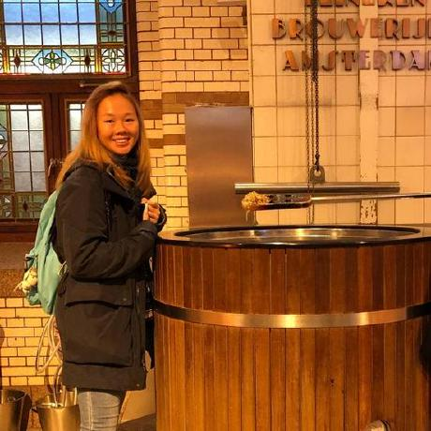
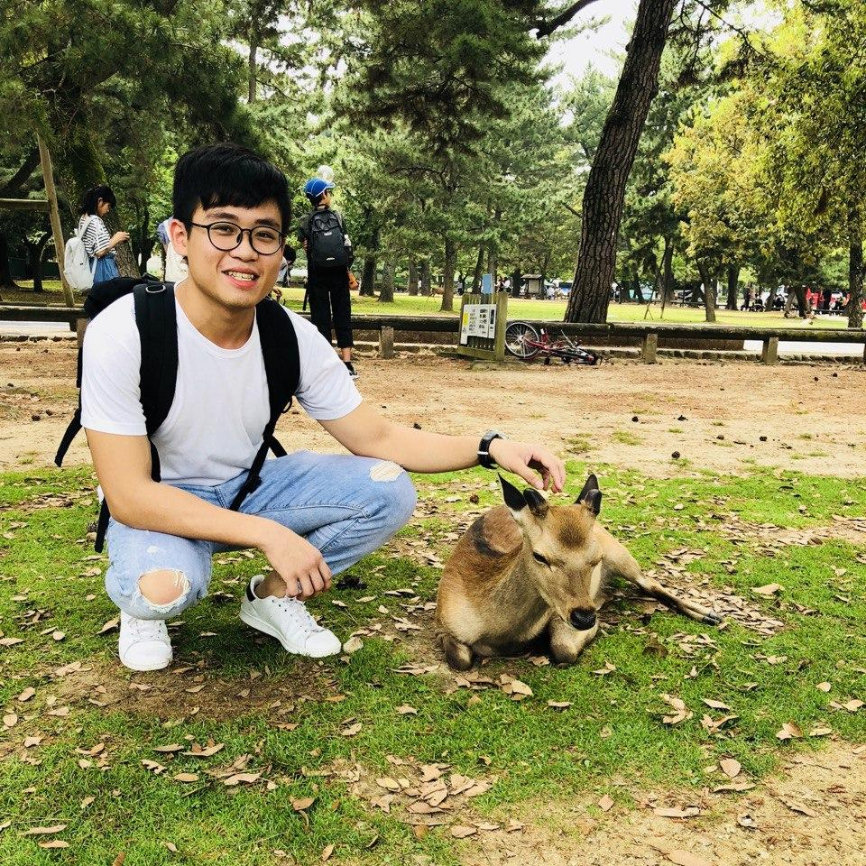
Code along with…
Diane Yeo
Y4 Business Analytics
https://www.linkedin.com/in/yeo-diane-suting/
Matthew Chan
Y4 Business Analytics
https://www.linkedin.com/in/matthew-chan-b835a3184/

Slide 3
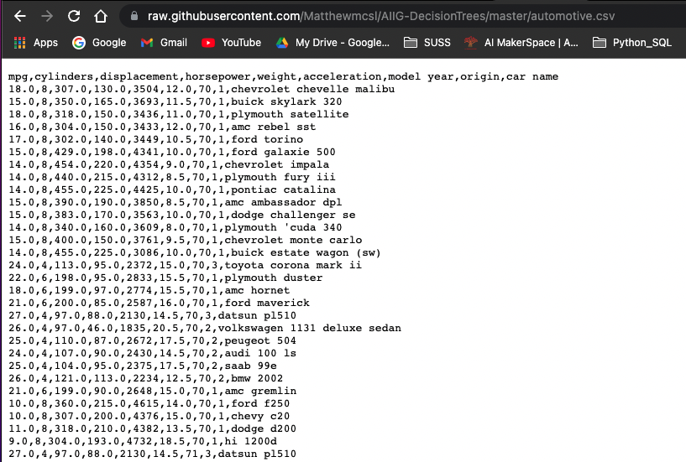
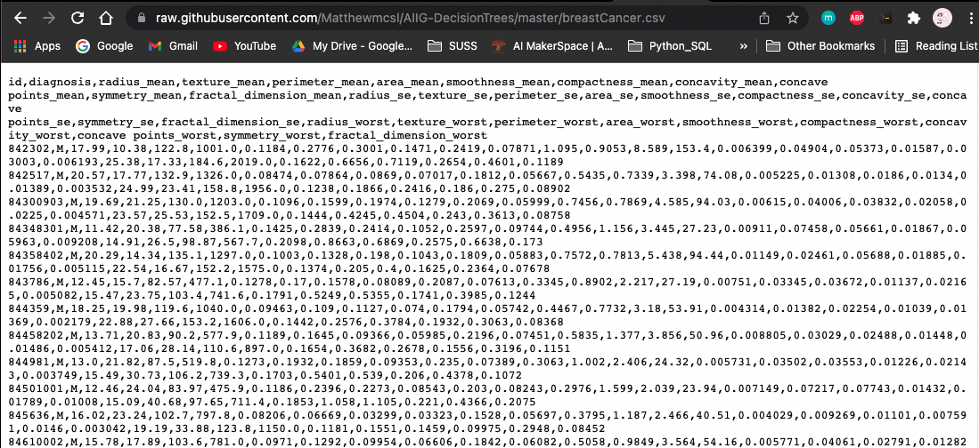
Datasets
Click on the two links (csv files) sent in the chat
https://raw.githubusercontent.com/Matthewmcsl/AIIG-DecisionTrees/master/automotive.csv
https://raw.githubusercontent.com/Matthewmcsl/AIIG-DecisionTrees/master/breastCancer.csv
Save them on your desktop (or anywhere easily accessible)
automotive.csv
breastCancer.csv

Slide 4
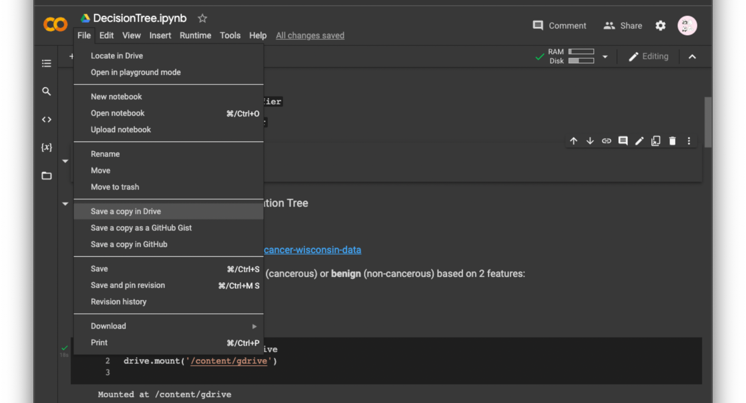
Colab Notebook
Click on the link sent
https://colab.research.google.com/drive/16kK5hWWsKADDDWyrt-2ONh2qJup1NJ21?usp=sharing
Make a copy of the colab notebook and save it on your own google drive
‘File’ > ‘Save a copy in Drive’

Slide 5
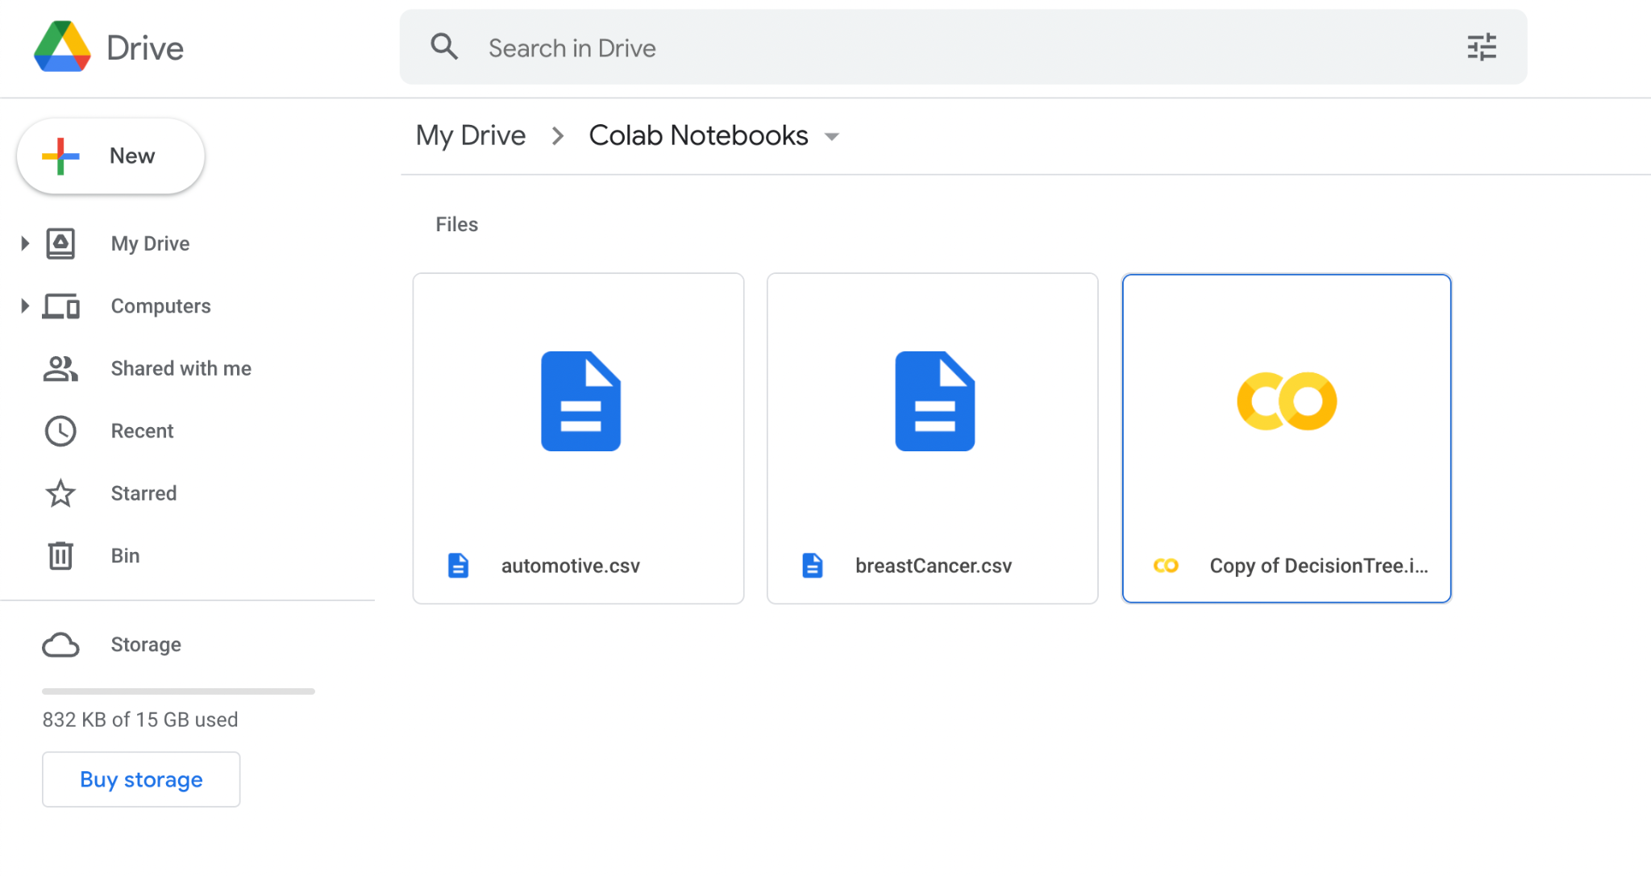
Upload .csv files into Drive
Upload the two .csv files saved on desktop into the same folder as the Colab notebook.
Your Colab Notebook folder in Drive should have 3 files:
automotive.csv
breastCancer.csv
DecisionTree.ipynb

Slide 6
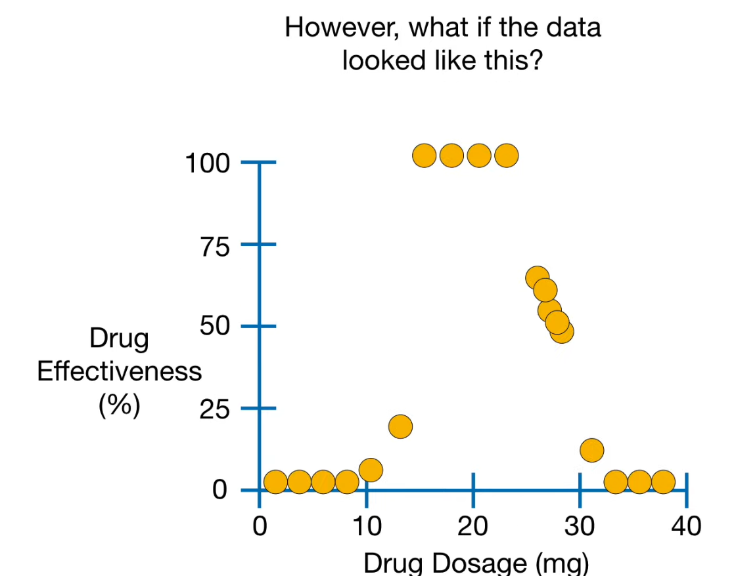
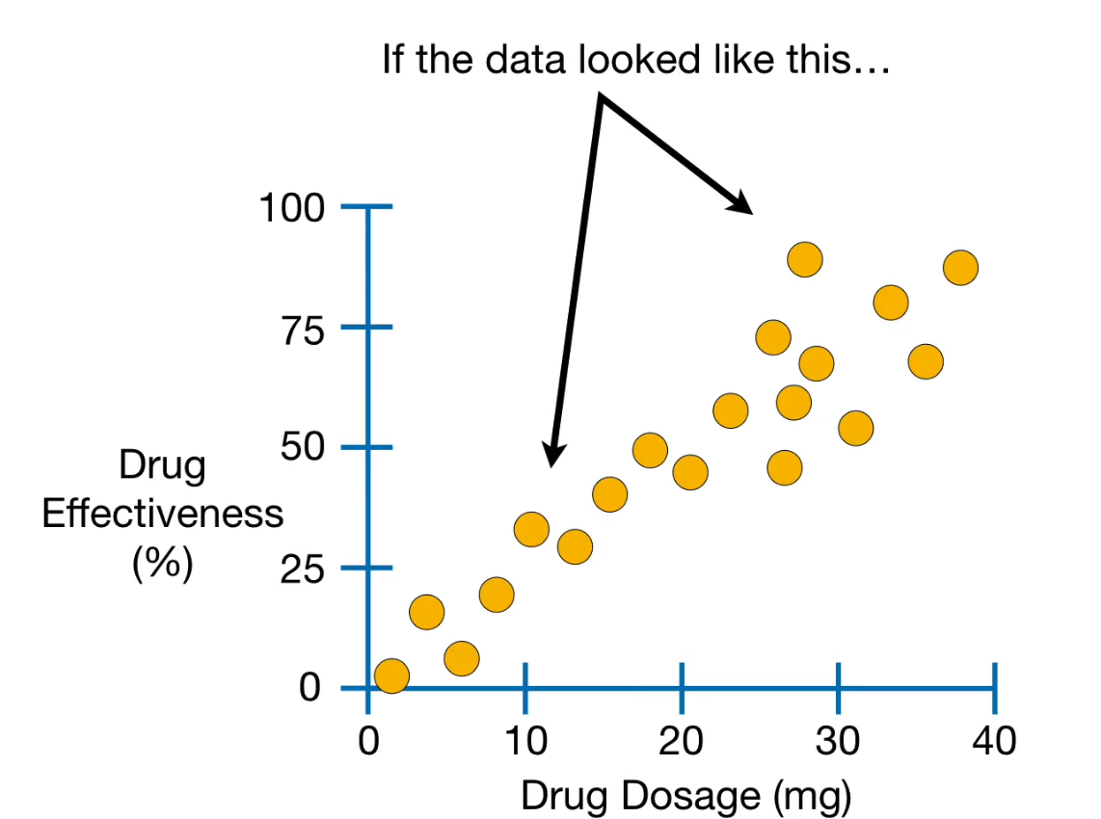
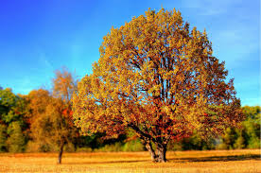

Why a regression tree over linear regression ?
You might have heard of Linear Regression..

Slide 7
Intuition for Regression Trees
Dosage < 14.5
True
False
Effective: 4.2%
Dosage >= 29
True
False
Effective: 2.5%
Dosage >= 23.5
True
False
Effective: 52.8%
Effective: 100%
Notes:
Draw 2 lines

Slide 8
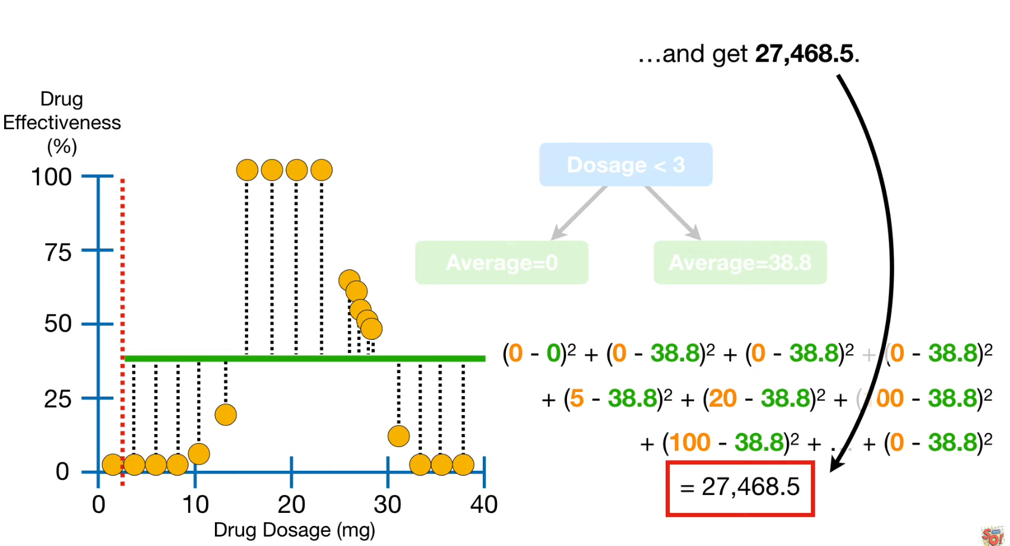
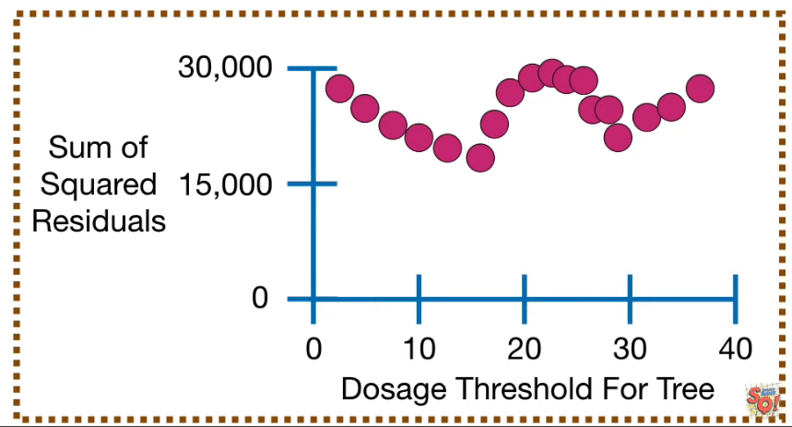
Very high level view of how it works..
14.5mg!
Sum of Squared Residual
Keep iterating until we reach hit a stopping criterion… (Max depth, min sample in a leaf.. etc.)

Slide 9
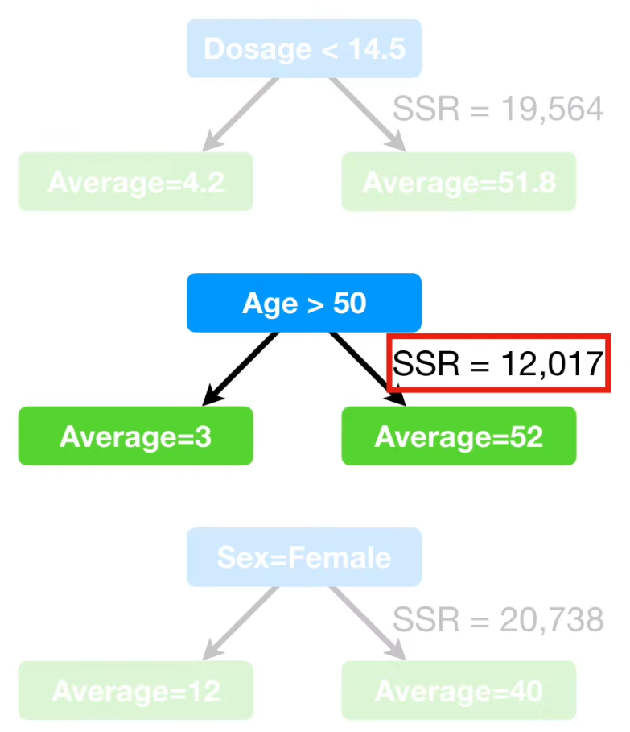
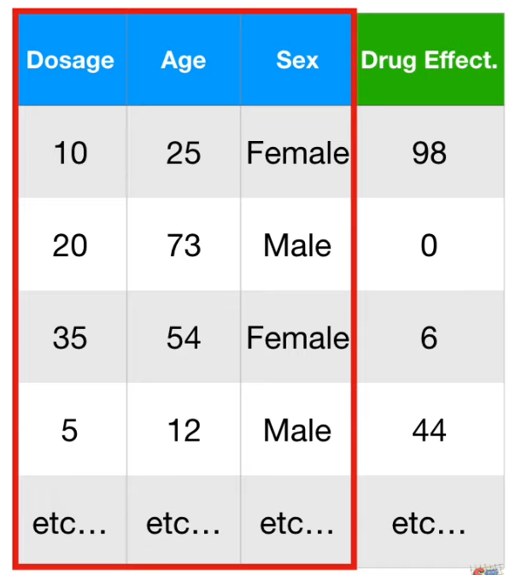
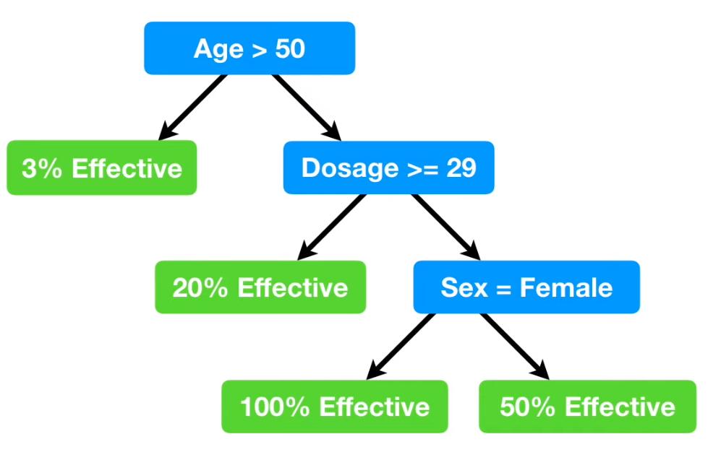
How about multiple features in our dataset?
Find the best candidate for each feature

